Slide 1

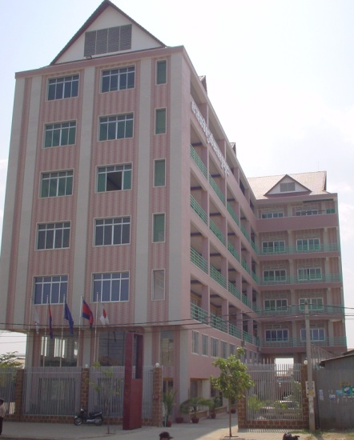
Welcome
to
Cambodian Mekong University
CMU
is the university that cares for the value of education

Slide 2
TODAY
CAMBODIAN MEKONG UNIVERSITY
PRESENT YOU
WHAT IS
M A R K E T I N G ?

Slide 3


WHY STUDY
M A R K E T I N G ?
Presented by.
Lec. James Kheng SOK
Master of Business Administration
Charles Sturt University, Australia
Director, the Mekong School of Marketing
Cambodian Mekong University is the university that cares for the value of education

Slide 4

TVC (Television Commercial)
A Part of Marketing
Apple - iPad 2 - TV Ad - We Believe - YouTube
KFC Hong Kong-Barack Obama TV Commercial 2011-YouTube
Kaka vs Drogba - FUNNY Pepsi Commercial [MUST SEE] - YouTube
Cambodian Mekong University is the university that cares for the value of education

Slide 5
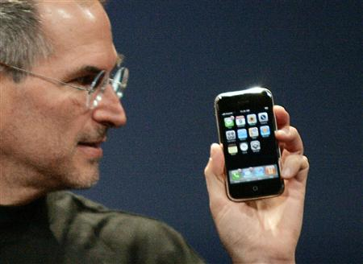
Steve Jobs, Co-Founder and former CEO Apple
YouTube - WWDC- Apple announces iPhone 4
Cambodian Mekong University is the university that cares for the value of education

Slide 6

Apple introduce iPhone 4s
Apple - Introducing iPhone 4S - YouTube
Cambodian Mekong University is the university that cares for the value of education

Slide 7
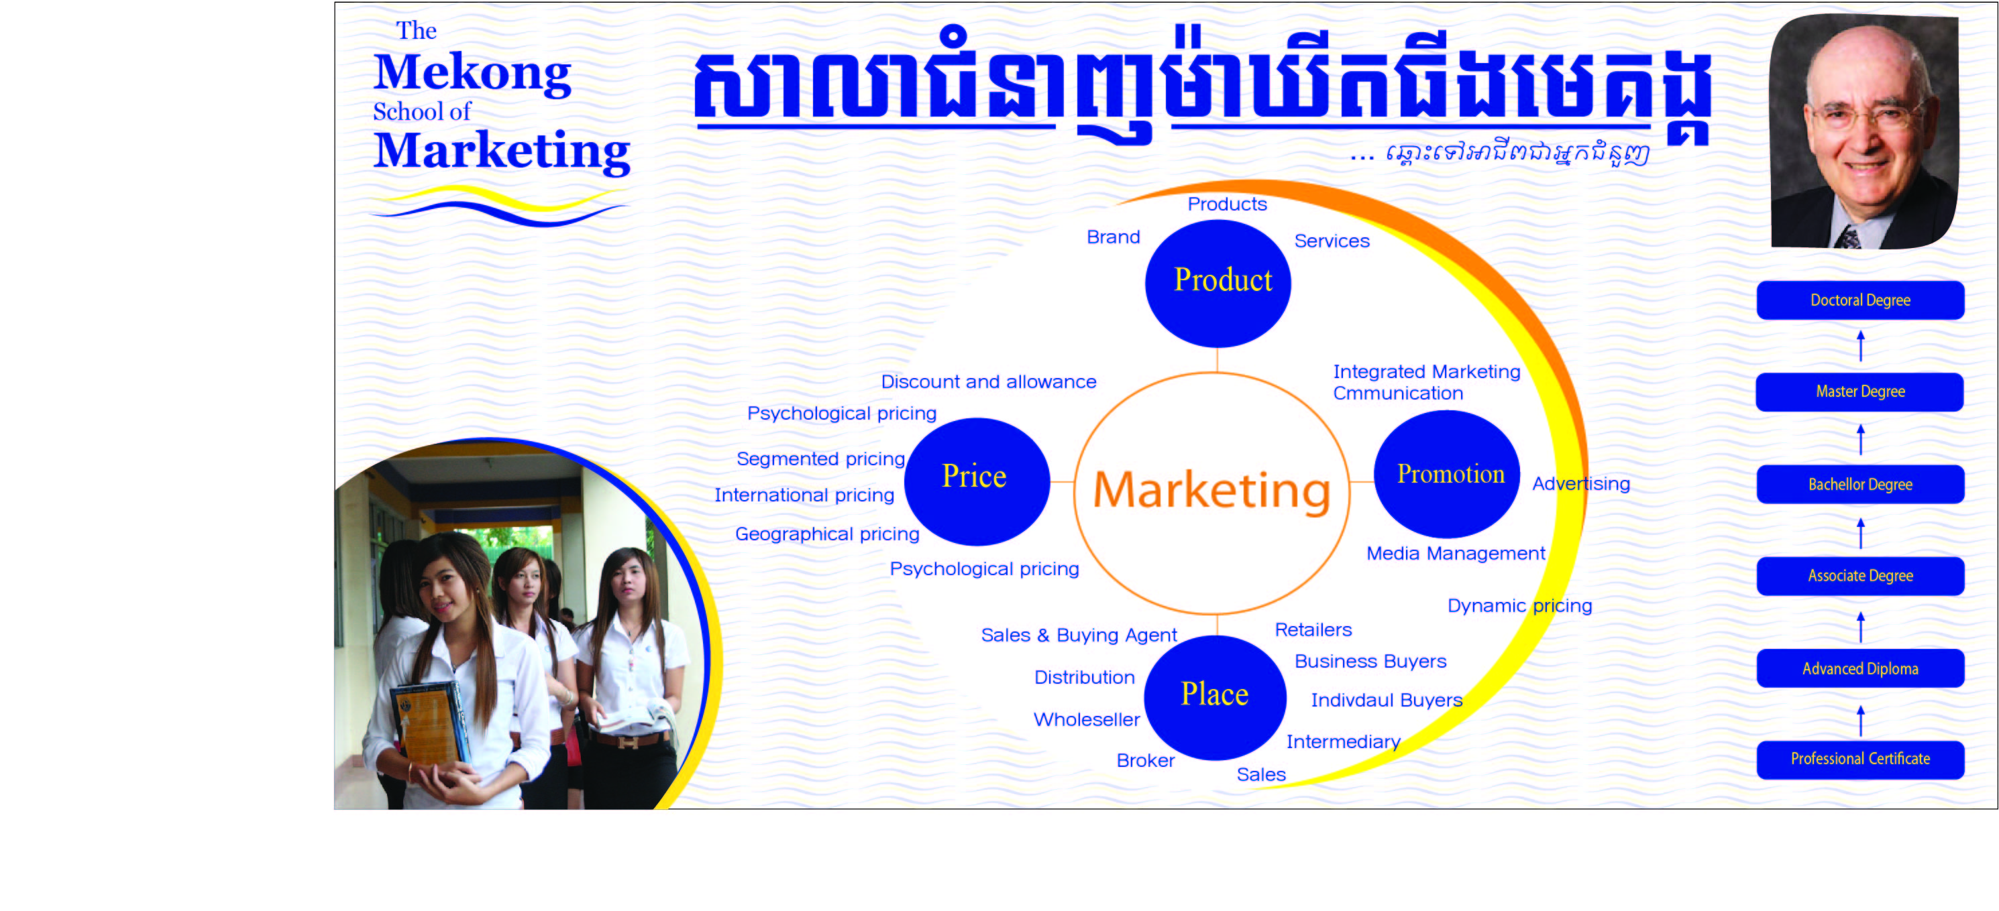
Dr. Philip Kotler, World Best-Selling Author
YouTube - Philip Kotler
Cambodian Mekong University is the university that cares for the value of education

Slide 8
Selling and Marketing
It is not just a business people who practice the art of selling.
Presidents of the United States of America encourage and persuade politicians in congress to support certain programs.
Cambodian Mekong University is the university that cares for the value of education

Slide 9
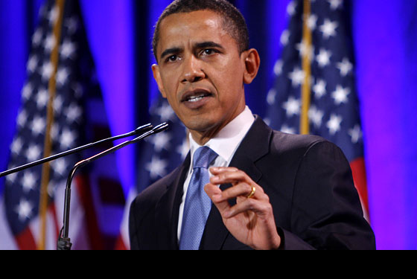
President Barak Obama
YouTube - President Obama Roasts Donald Trump At White House Correspondents' Dinner!
Cambodian Mekong University is the university that cares for the value of education

Slide 10
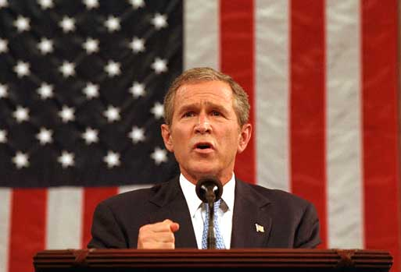
President Gorge W. Bush
CNN - Ex-President George W. Bush's Post 9_11 Speech - YouTube
Cambodian Mekong University is the university that cares for the value of education

Slide 11
Selling and Marketing
Charities solicit contribution and volunteer to run organization. (Ex. Blood Donation)
Scientists try to convince government agencies to fund research.
Cambodian Mekong University is the university that cares for the value of education

Slide 12
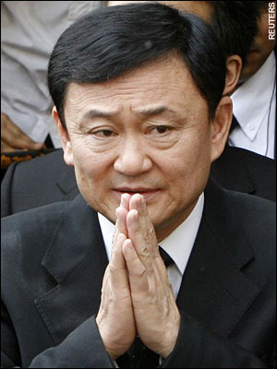
Selling and Marketing
Politicians use this sales technique to convince voters to support in election and agree their opinion.
2009-11-12 Thaksin Shinawatra Speech Press Conference Part 4 - YouTube
Cambodian Mekong University is the university that cares for the value of education

Slide 13

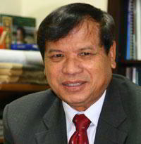
Thong Khon, Minister of Tourism
Cambodia Town's Delegation at the Opening Night of 2011 ASEAN Tourim Expo in Phnom Penh.MPG - YouTube
Cambodian Mekong University is the university that cares for the value of education

Slide 14
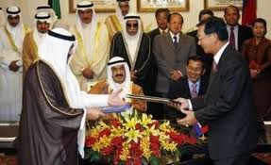
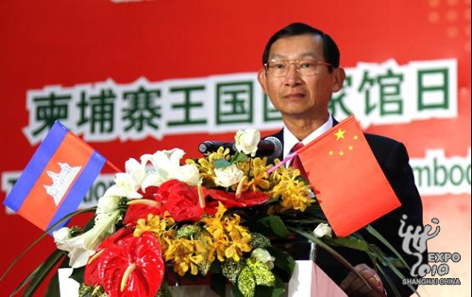
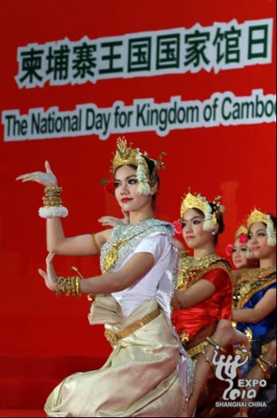
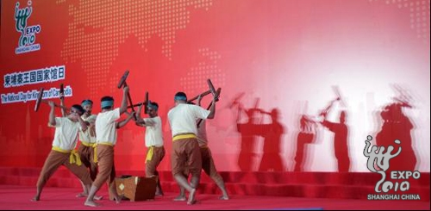
Cham Prasidh, Minister of Commerce
He was speaking Khmer to Kuwait Prince and to Chinese leaders
on
trade
deal
joking
Cambodian Mekong University is the university that cares for the value of education

Slide 15
Selling and Marketing
Principles of Selling are useful to everyone not just people with the title of salesperson. How you sell your ideas.
Look at some examples:
As a college student; you might use selling another student to go out on a date or to ask a professor to let you submit assignment that is closed out.
Cambodian Mekong University is the university that cares for the value of education

Slide 16
Selling and Marketing
When you near graduation, you will certainly confront a very importance sales job selling yourself to an employer.
To get a job, you will go through the same steps used in the sales process.
First you will identify some potential employers (customers).
On the basic of an analysis of each employ’s needs, you will develop a presentation (as well as answers to questions you might encounter) to demonstrate your ability to satisfy those needs.
Cambodian Mekong University is the university that cares for the value of education

Slide 17
Selling and Marketing
During the interview you will listen to what the recruiter says, ask and answer questions, at some point you might negotiate with the employer over starting salary or other issues.
Eventually you will try to secure a commitment from the employer to hire you.
In this process you will need to have a very professional level of sales job.
You will need to use selling principles all the time in every industrial.
Cambodian Mekong University is the university that cares for the value of education

Slide 18
Marketing & Business
What is Business
Business
Create Customer
Retain Customer
Profitable
$$$$$
Cambodian Mekong University is the university that cares for the value of education

Slide 19
Marketing Mix (4Ps)
Product
Price
Place
Promotion
Cambodian Mekong University is the university that cares for the value of education

Slide 20


WHAT IS MARKETING?
Cambodian Mekong University is the university that cares for the value of education

Slide 21
Marketing
Activities
Cambodian Mekong University is the university that cares for the value of education

Slide 22
Billboard (Brand Displaying)
Cambodian Mekong University is the university that cares for the value of education

Slide 23
Media Communication
TVC (Television Commercial)
iPhone 3GS Ad - Gift - YouTube
iPhone 3G S need for speed ad - YouTube
iPhone 3G S need for speed ad - YouTube
Cambodian Mekong University is the university that cares for the value of education

Slide 24
Media Communication
Radio Spot
Cambodian Mekong University is the university that cares for the value of education

Slide 25
Publishing & Printing
Magazine, Newspaper
Artwork - Fort
Artwork - OCS
Cambodian Mekong University is the university that cares for the value of education

Slide 26
Publishing & Printing
Poster, Brochure, Bunting, Sticker, Banner
Cambodian Mekong University is the university that cares for the value of education

Slide 27


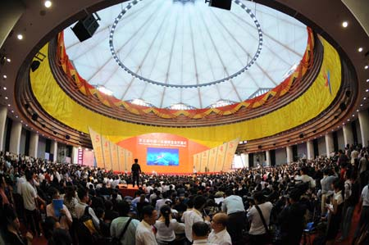
World Expo
Cambodian Mekong University is the university that cares for the value of education

Slide 28
CD, VCD & DVD REAK SMEY HANG MEAS
TVC RHM
Cambodian Mekong University is the university that cares for the value of education

Slide 29
CD, VCD & DVD BIGE MAN
Big man production promotion
Cambodian Mekong University is the university that cares for the value of education

Slide 30
Marketing & Sales Concepts Contrasted
The Selling Concept
Starting
Point
Focus
Means
Ends
Factory
Existing
Products
Selling
and
Promoting
Profits
through
Volume
The Marketing Concept
Market
Customer
Needs/wants
Integrated
Marketing
Profits
through
Satisfaction

Slide 31
PROGRAM OFFER
Cambodian Mekong University is the university that cares for the value of education

Slide 32
PROGRAM STRUCTURE
Foundation Courses (FC) 30 Credits
General Courses (GC) 15 Credits
Business & Management Core Courses 30 Credits
Major Required Courses 30 Credits
Major Concentration Courses 15 Credits
Elective Courses 6 Credits
Total: 126 Credits
Cambodian Mekong University is the university that cares for the value of education

Slide 33
FOUNDATION COURSE
Semester 1
Sub Code Subject Name Credits
COM101 Computer Application 1 M/P
EC101 Economics Thinking 3
EI111 Listening and Speaking Skill M/P
EN101 English Language Level 1 3
HU127 Intro. to Human Communication 3
MB101 College Mathematics 3
MN109 Understanding Business 3
Total: 15 Credits
Cambodian Mekong University is the university that cares for the value of education

Slide 34
FOUNDATION COURSE
Semester 2
Sub Code Subject Name Credits
AC101 Accounting 1A 3
COM103 Computer Application 3 M/P
EC102 Understanding a Nation Economy 3
EI102 English Improvement 2 M/P
EN102 English Language Level 2 3
HU129 Fundamental of Leadership 3
MB102 Introduction to Statistics 3
Total: 15 Credits
Cambodian Mekong University is the university that cares for the value of education

Slide 35
YEAR 2
Semester 1
Sub Code Subject Name Credits
AC201 Fundamentals of Managerial Accounting 3
COM104 Computer Application 4 M/P
EI103 English Improvement 3 M/P
EN103 English Language Level 3 3
FN201 Corporate Finance 3
MK101 Principles of Marketing 3
MN101 Principles of Management 3
Total: 15 Credits
Cambodian Mekong University is the university that cares for the value of education

Slide 36
YEAR 2
Semester 2
Sub Code Subject Name Credits
BS201 Business Statistics and Software Application 3
COM105 Computer Application 5 M/P
EI104 English Improvement 4 M/P
EN104 English Language Level 4 3
MK312 Service Marketing 3
MN201 Organizational Behavior 3
MN310 Operation Management 3
Total: 15 Credits
Cambodian Mekong University is the university that cares for the value of education

Slide 37
YEAR 3
Semester 1
Sub Code Subject Name Credits
MN315 International Business Environment 3
MK313 Consumer Behavior 3
LA201 Principles of Business Law 3
MK238 Retail Promotion 3
COM106 Computer Application 6 M/P
EI105 English Improvement 5 M/P
EN105 English Language Level 5 3
Total: 15 Credits
Cambodian Mekong University is the university that cares for the value of education

Slide 38
YEAR 3
Semester 2
Sub Code Subject Name Credits
MN400 Research Method 3
MK310 Sales Management 3
MK318 Principles of Electronic Commerce 3
MK237 Retail Management 3
MK236 Retail Buying and Merchandising Management3
EN105 English Language Level 6 3
Total: 18 Credits
Cambodian Mekong University is the university that cares for the value of education

Slide 39
YEAR 4
Semester 1
Sub Code Subject Name Credits
MK168 Research in Marketing 3
MK326 Marketing Logistics 3
MK239 Retail Sales Promotion 3
MK324 Marketing Decision Making 3
EN107 English Language Level 7 3
MK316 International Marketing 3
Total: 18 Credits
Cambodian Mekong University is the university that cares for the value of education

Slide 40
YEAR 4
Semester 2
Sub Code Subject Name Credits
MK319 Global Marketing 3
MK328 Purchasing and Supply Chain Management 3
MK314 Integrated Marketing Communication 3
Total: 9 Credits
Cambodian Mekong University is the university that cares for the value of education

Slide 41
JOB MARKET
Large number of jobs.
High demand.
Shortage of skilful people in sales and marketing.
Cambodian Mekong University is the university that cares for the value of education

Slide 42
JOB STATISTIC
www.pelprek.com (Sep 16, 2011)
Sales and Marketing 107 jobs
Accounting/Finance 68 jobs
Customer Service 10 jobs
Admin/HR 13 jobs
Cambodian Mekong University is the university that cares for the value of education

Slide 43
JOB STATISTIC
www.bongthom.com (Sep 16, 2011)
Sales and Marketing (leading)
No number summarization
Cambodian Mekong University is the university that cares for the value of education

Slide 44
JOB OPPORTUNITIES
Sales/Marketing Manager
Client Relationship Manager
Account Team Manager
Vendor and Channel Manager
Cambodian Mekong University is the university that cares for the value of education

Slide 45
JOB OPPORTUNITIES
Information Provider to the Firm
Trade Sales Manager
Distributor Sales Manager
Industrial Sales Manager
Cambodian Mekong University is the university that cares for the value of education

Slide 46
JOB OPPORTUNITIES
Retail Sales Manager
Direct Sales Manager
Customer Service Manager
Sales & Marketing Manager
Cambodian Mekong University is the university that cares for the value of education

Slide 47
JOB OPPORTUNITIES
Event Organizer
Trade Expo Organizer
Product and Brand Manager
Marketing Research Manager
Cambodian Mekong University is the university that cares for the value of education

Slide 48
JOB OPPORTUNITIES
Market/Customer Specialist
Advertising, Sales Promotion Specialist
Higher chance to be entrepreneur
Cambodian Mekong University is the university that cares for the value of education

Slide 49
JOB STATISTIC
Number of CMU Students
Where do they work?
Job Rate
Cambodian Mekong University is the university that cares for the value of education

Slide 50
OUT SIDE FIRMS
RMA Group
Medico Supply Co.; Ltd
Cambodian Mekong University is the university that cares for the value of education

Slide 51
THANK YOU
Q???
Cambodian Mekong University is the university that cares for the value of education

